Slide 1
Machine Learning -
Basic Principles & Practice
6. The Curse of Dimensionality
机器学习 - 基础原理与实践
6. 维度的诅咒
Cong Li 李聪

Slide 2

Should You Still Remember …
倘若你依然记得……
Sense 词义 | Example 例句
兴趣 | Reading is one of my interests
利益 | In this case, my interests conflict with yours
利息 | The Fed cut interest rates again
… | …

Slide 3
Perceptron 感知器
What We Have Seen 我们已经看到
  Attribute importance discriminated
  属性的重要性被区分开来
What We Expect 我们期望
  A nice solution working robust
  一个在各种条件下适用的好方法
What We Want to Know 我们想知道
  How ideal it really works?
  它是否真正理想？

Slide 4
Synthetic Problems Again?
又是人造问题？
This time much more complicated
这次复杂多了

Slide 5
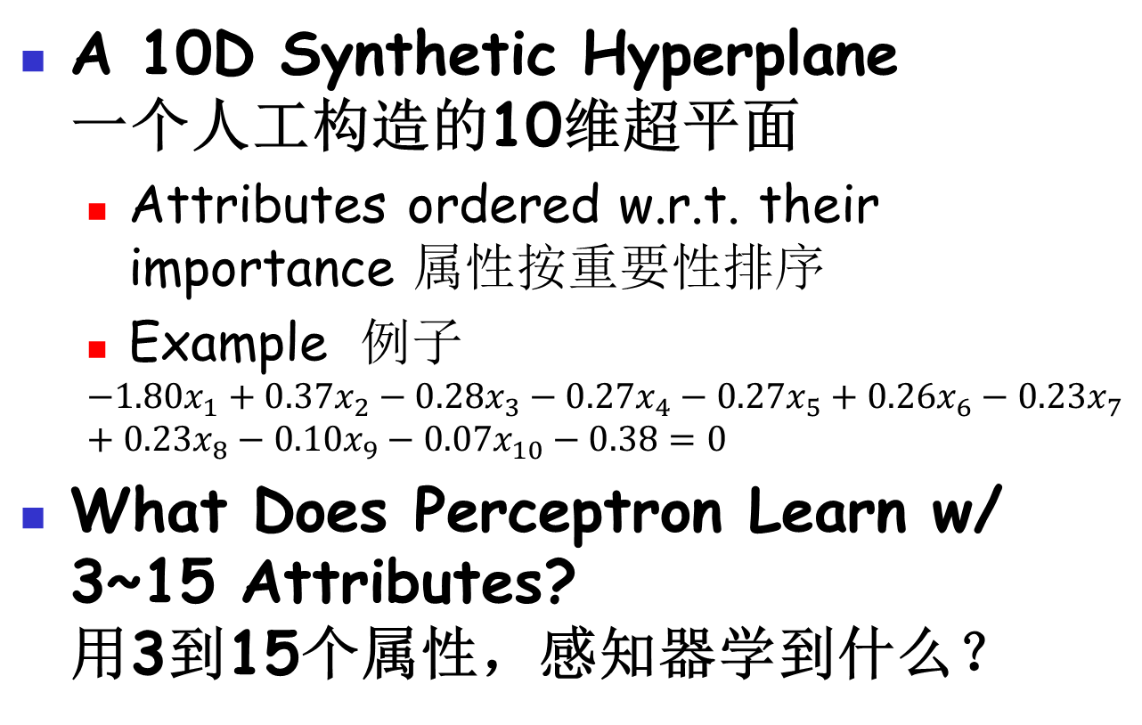
The Problem 这个问题
A 10D Synthetic Hyperplane
一个人工构造的10维超平面
  Attributes ordered w.r.t. their importance 属性按重要性排序
  Example 例子
  $${−1.80x}_{1}+0.37x_{2}−0.28x_{3}−0.27x_{4}−0.27x_{5}+0.26x_{6}−0.23x_{7}+0.23x_{8}−0.10x_{9}−0.07x_{10}−0.38=0$$
What Does Perceptron Learn w/ 3~15 Attributes?
用3到15个属性，感知器学到什么？

Slide 6

Practice 6.1 实践6.1
Practice time: use perceptron on those 10-attribute synthetic problems w/ 3~15 attributes 实践时刻：对于这些10个属性的人造问题，用3到15个属性，以感知器进行学习
How does it perform w.r.t. changing number of attributes?
随着属性数的变化，感知器的表现如何？

Slide 7
Result： Training Size 20
结果：训练数据量为20
Taking the 3 most important attributes does not seem to perform well enough
使用3个最重要的属性效果似乎差强人意
Many other relevant features are overlooked 其他相关属性被忽视了

Slide 8
Result： Training Size 20
结果：训练数据量为20
But taking the 10 relevant attributes does not do better
使用10个相关属性也不怎么样
Taking 15 attributes is even worse
使用15个属性更糟

Slide 9
Result： Training Size 20
结果：训练数据量为20
Best results are obtained by disregarding 3~4 less relevant attributes
最佳结果来自于忽略3到4个不那么相关的属性
How can that happen? 怎么会这样？

Slide 10


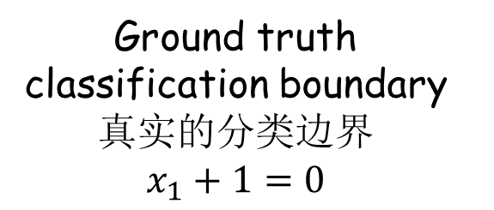
Do You Still Remember?
你还记得吗？
In Practice 5.1 在实践5.1中
Ground truth classification boundary 真实的分类边界
$x_{1}+1=0$
Classification boundary learned by perceptron 感知器学习到的分类边界
$$36.73x_{1}−0.42x_{2}+26=0$$
$$⟺x_{1}−0.01x_{2}+0.71=0$$

Slide 11
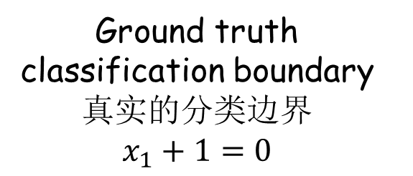
Illustration 说明 (1)
  Attribute 2 属性2
Ground truth classification boundary 真实的分类边界
$x_{1}+1=0$
  Attribute 1
  属性1
  Training data 训练数据
  Unseen data 未见数据

Slide 12
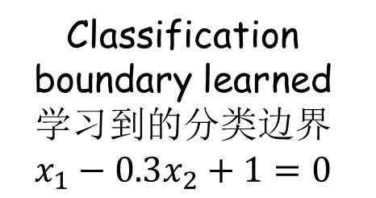
Illustration 说明 (1)
  Attribute 2 属性2
Classification boundary learned 学习到的分类边界
$x_{1}−0.3x_{2}+1=0$
  Attribute 1
  属性1
  Training data 训练数据
Irrelevant attribute rated w/ importance 不相关的属性被赋予了重要性

Slide 13
Illustration 说明 (1)
  Attribute 2 属性2
  Attribute 1
  属性1
  Training data 训练数据
More data rejects the hyperplane
更多的数据否定了它
  More data
  更多数据

Slide 14
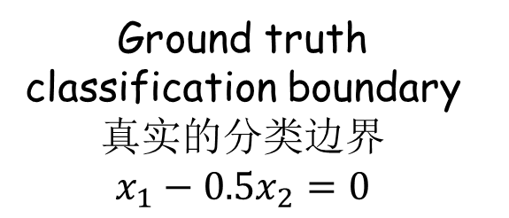
Illustration 说明 (2)
  Attribute 2 属性2
Ground truth classification boundary 真实的分类边界
$x_{1}−{0.5x}_{2}=0$
  Attribute 1
  属性1
  Training data 训练数据
  Unseen data 未见数据

Slide 15
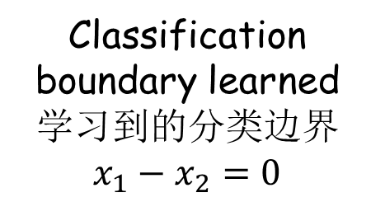
Illustration 说明 (2)
  Attribute 2 属性2
Classification boundary learned 学习到的分类边界
$x_{1}−x_{2}=0$
  Attribute 1
  属性1
  Training data 训练数据
Less important attribute overrated 高估了不那么重要的属性

Slide 16
Illustration 说明 (2)
  Attribute 2 属性2
  Attribute 1
  属性1
  Training data 训练数据
More data rejects the hyperplane
更多的数据否定了它

Slide 17
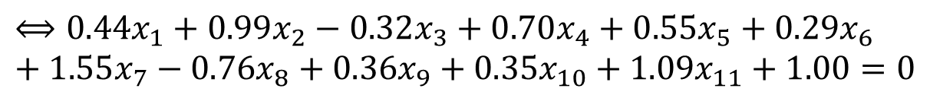
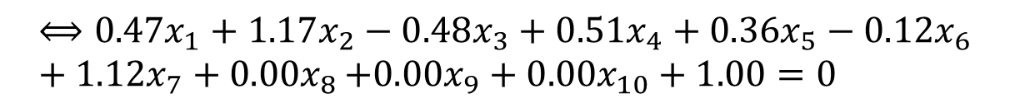
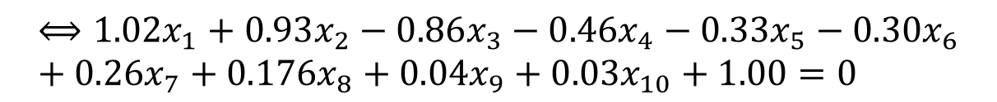
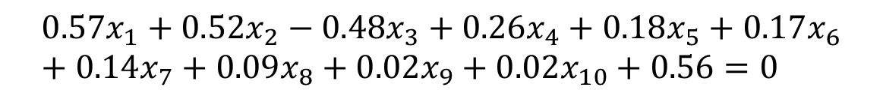
Example 实例 (1)
Ground truth classification boundary 真实分类边界
$${0.57x}_{1}+0.52x_{2}−0.48x_{3}+0.26x_{4}+0.18x_{5}+0.17x_{6}+0.14x_{7}+0.09x_{8}+0.02x_{9}+0.02x_{10}+0.56=0$$
$$⟺{1.02x}_{1}+0.93x_{2}−0.86x_{3}−0.46x_{4}−0.33x_{5}−0.30x_{6}+0.26x_{7}+0.176x_{8}+0.04x_{9}+0.03x_{10}+1.00=0$$
Learned w/ 7 attributes 用7个属性学习到的
$$⟺{0.47x}_{1}+1.17x_{2}−0.48x_{3}+0.51x_{4}+0.36x_{5}−0.12x_{6}+1.12x_{7}+0{.00x}_{8}+0.00x_{9}+0.00x_{10}+1.00=0$$
Learned w/ 11 attributes 用11个属性学习到的
$$⟺{0.44x}_{1}+0.99x_{2}−0.32x_{3}+0.70x_{4}+0.55x_{5}+0.29x_{6}+1.55x_{7}−0.76x_{8}+0.36x_{9}+0.35x_{10}+1.09x_{11}+1.00=0$$

Slide 18
Example 实例 (2)
 | w₁ | w₂ | w₃ | w₄ | w₅ | w₆ | w₇ | w₈ | w₉ | w₁₀ | w₁₁ | b
T | 1.02 | 0.93 | -0.86 | 0.46 | 0.33 | 0.30 | 0.26 | 0.16 | 0.04 | 0.03 | 0.00 | 1.00
7 | 0.47 | 1.17 | -0.48 | 0.51 | 0.36 | -0.12 | 1.12 | 0.00 | 0.00 | 0.00 | 0.00 | 1.00
11 | 0.44 | 0.99 | -0.32 | 0.70 | 0.55 | 0.29 | 1.55 | -0.76 | 0.36 | 0.35 | 1.09 | 1.00
Importance of some attributes gets overrated or incorrectly rated
某些属性的重要性被高估或被错估了

Slide 19
Overfitting 过度拟合 (1)
Learning Is Not Perfect 学习不完美
Perceptron 感知器
  Learn a hyperplane separating training data 学习到一个划分训练数据的超平面
    Depending on the random data distribution
    取决与训练数据的随机分布
  The hyperplane 这个超平面
    Overrate or incorrectly rate the importance of some attributes (or even irrelevant attributes) 可能高估或错估了某些属性（甚至是不相关的属性）的重要性

Slide 20
Overfitting 过度拟合 (2)
More Weak/Irrelevant Attributes in Learning 更多的弱/不相关属性参与学习
  More likely those attributes get confounded by randomness
  这些属性更可能受到随机性干扰
To Alleviate the Problem 欲缓和该问题
  More data to rescue 更多的数据来拯救
    Reduce the odds from randomness
    降低随机因素带来的偶然性

Slide 21
Result： More Training Data
结果：更多训练数据
Taking the 3 most important attributes does not seem to perform much better
使用3个最重要的属性时改善不多

Slide 22
Result： More Training Data
结果：更多训练数据
Smoother performance w/ more attributes
用更多的属性时性能变化平缓

Slide 23
Real World Problem
真实的问题
Much More Complicated in Analysis
分析起来更为复杂
  Do not know the ground truth 真相未知
    May not even be a linear classification problem
    甚至未必是个线性问题
    Attribute importance unknown 属性重要性未知
Just to Get an Idea 仅仅感受一下
  Word sense disambiguation for ‘interest’
  词义消歧：“interest”

Slide 24
Practice 6.2 实践6.2
Practice time: try to use only the top 1000~8000 words in a mysterious dictionary
实践时刻：尝试从一本神秘的字典中使用前1000到8000个词
How does it perform w.r.t. changing number of words?
随着词的数量变化，感知器的表现如何？

Slide 25
Result 结果
Even if we do not know the ground truth, using part of the words outperforms using all the words
即便真相未知，用一部分词比用所有的词好

Slide 26
The Reality 现实情况
Using Less Attributes 少用些属性
  Not appropriate 不合适
    Cannot accurately assess attribute importance
    准确评估属性重要性很难
    Give a training size, one do not know the matching attribute number 给定训练数据量，我们不知道匹配的属性数量
      More data cannot help w/ too few attributes
      属性太少时更多的数据也不顶用
With All the Attributes 更多的属性
  More data can rescue 更多的数据能有效
  & we may have other methodologies
  而且我们也许还有别的办法

Slide 27
The End

